Slide 1
Murach’s Modern JavaScript
Chapter 1
How to code and run your first apps

Slide 2
Objectives
Applied
Use VS Code to edit HTML, CSS, and JavaScript files.
Use an extension with VS Code to run an app in a web browser.
Use Chrome to run JavaScript apps that are on your computer or the internet.
Use Chrome’s developer tools to find the statement that caused an error in an app.
Knowledge
Describe the components of a web app.
Describe HTTP requests and responses.
Distinguish between static web pages and dynamic web pages.
Describe the use of JavaScript in a web app.
Describe the ECMAScript specification.
Describe a basic process for detecting syntax errors and runtime errors.

Slide 3
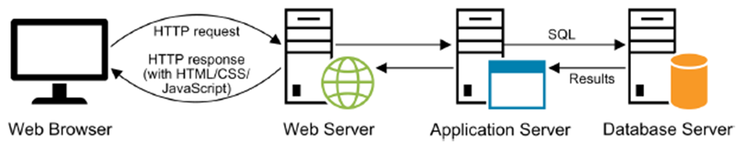
An HTTP request and response for a dynamic web page
Client-side and server-side processing
When an application server runs code to process an HTTP request, it’s known as server-side processing.
When the JavaScript engine of a web browser runs the JavaScript for a web page, it’s known as client-side processing.
Because JavaScript runs on the client, not the server, it can process the web page without requiring a trip back to the server.

Slide 4
ECMAScript version history
Version | AKA | Release date
1 |  | June 1997
2 |  | June 1998
3 | ES3 | December 1999
4 |  | Abandoned (never released)
5 | ES5 | December 2009
5.1 |  | June 2011
2015 | ES2015, ES6 | June 2015
2016 | ES2016, ES7 | June 2016
... | ... | ...
2022 | ES2022, ES13 | June 2022
2023 | ES2023, ES14 | June 2023
A browser compatibility table for ECMAScript
https://compat-table.github.io/compat-table/es2016plus/

Slide 5
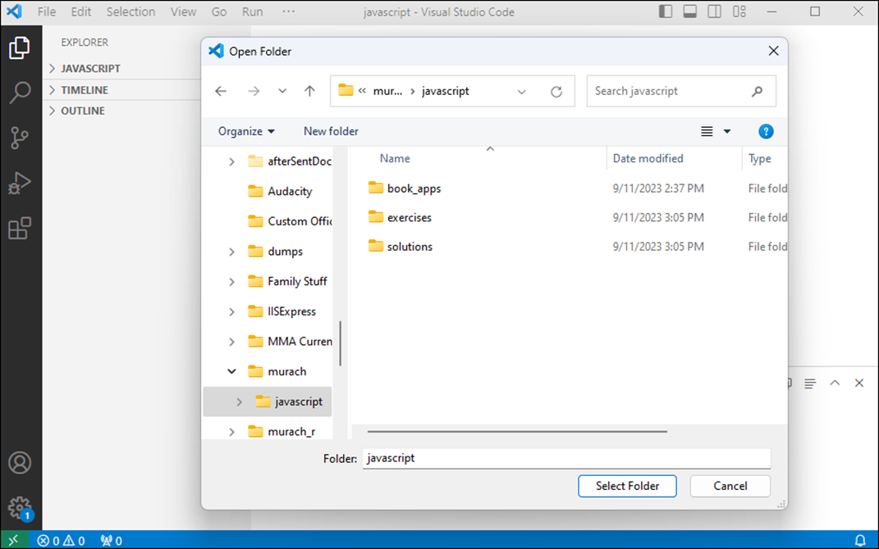
The dialog for choosing a folder in VS Code

Slide 6
Common tasks for working with folders
Open a folder
Close a folder
Add a folder
Rename a folder
Delete a folder

Slide 7
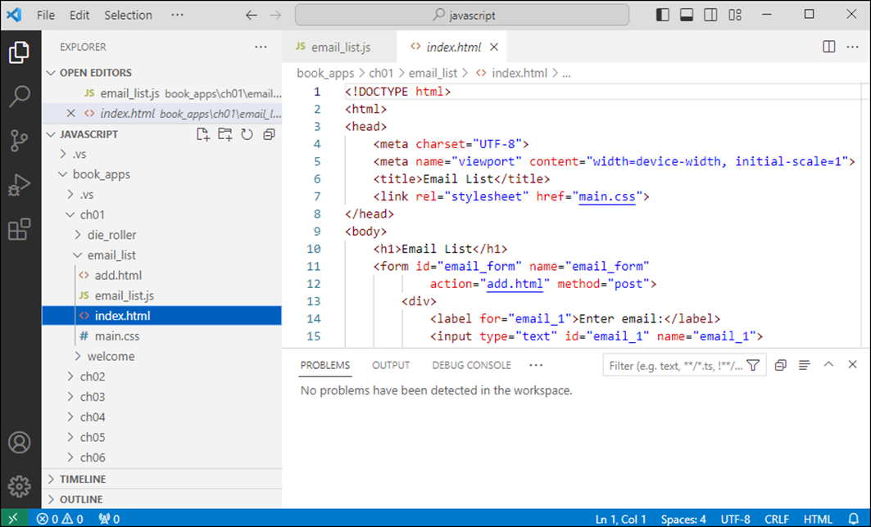
VS Code with files in Standard and Preview mode

Slide 8
Common tasks for working with files
Preview a file
Open a file
Display a file that’s already open
Close a single file or all open files
Save a single file or all open files
Add a new file to a folder
Rename a file
Delete a file

Slide 9
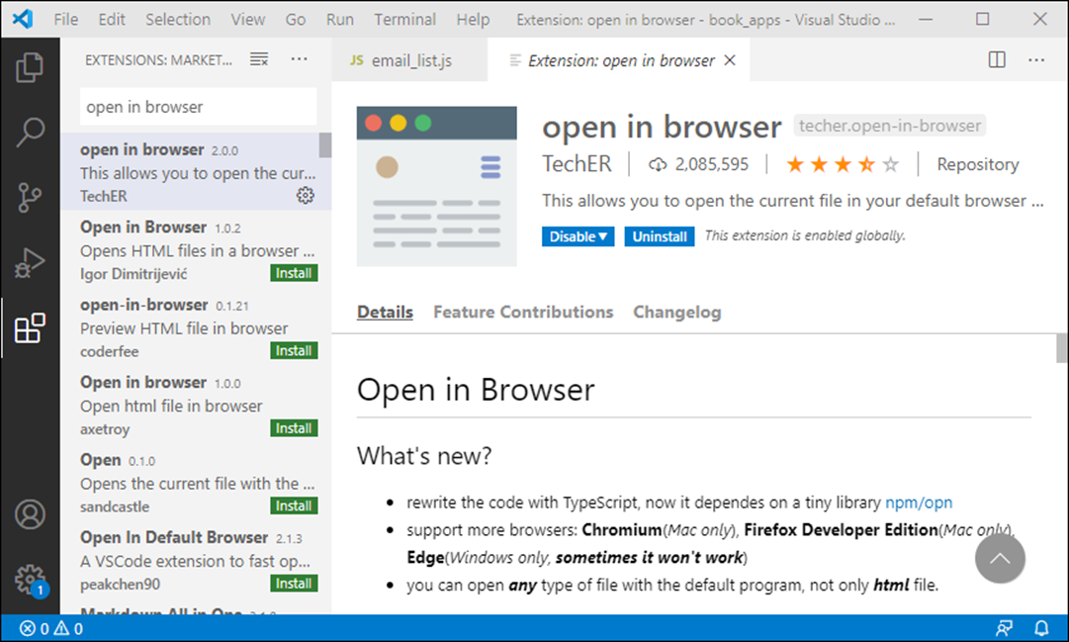
VS Code with the Open in Browser extension

Slide 10
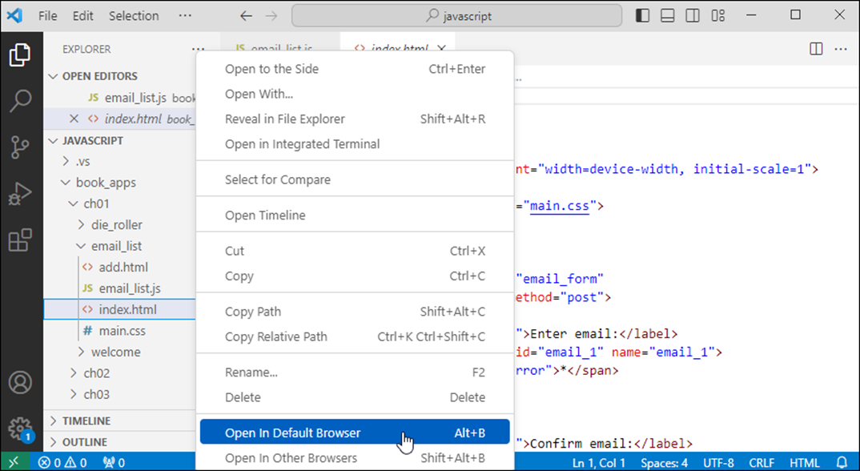
How to run an app using Open in Browser

Slide 11
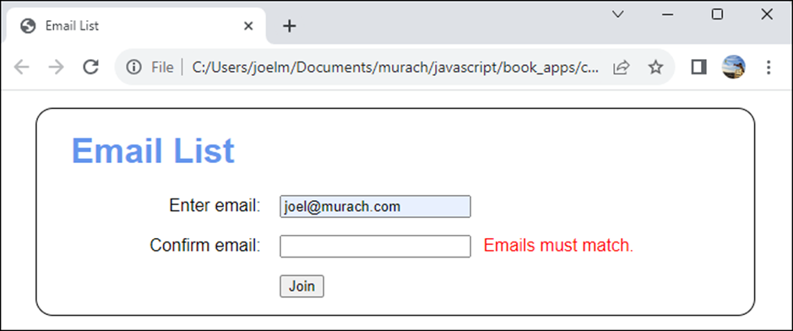
The web page that’s opened in Chrome

Slide 12
Common ways to open an HTML file with Open in Browser
Select Open in Default Browser to open the file in your default browser.
Select Open in Other Browsers to select the browser in which you want to open the file.
Use the extension’s shortcut keys to perform these operations.
Another way to open an HTML file
Select Reveal in File Explorer (Windows) to display the file in File Explorer or Reveal in Finder (macOS) to display it in Finder. Then, double-click the file to open it.

Slide 13
An app that displays a dialog
<!DOCTYPE html>
<html>
<head>
<title>Welcome</title>
</head>
<body>
<h1>Welcome to Modern JavaScript</h1>
<script>
// call a method that displays a dialog
alert("Hi!");
</script>
</body>
</html>

Slide 14
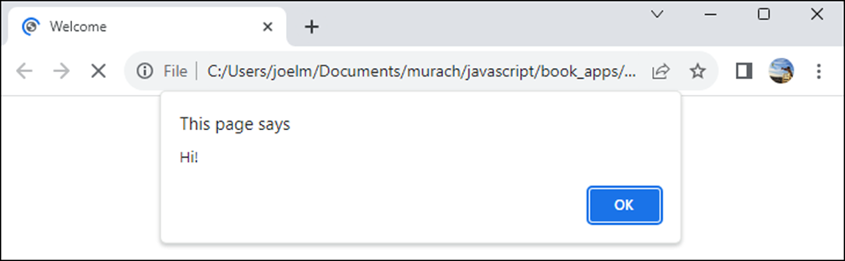
The browser and the dialog

Slide 15
How to create and run an app
Create a folder for the app.
Within that folder, create an HTML file for the app.
Enter HTML and JavaScript code into the HTML file.
Save the HTML file.
Press Alt+B to run the HTML file in the default browser.

Slide 16
How to include JavaScript code in an HTML file
Use a <script> element to include embedded JavaScript that includes comments, statements and built-in methods.
Use two forward slashes (//) to add a comment that’s ignored when the JavaScript is executed.
Use statements to perform tasks. A statement typically ends with a semicolon (;), though that isn’t required.
Use built-in methods to perform various tasks.

Slide 17
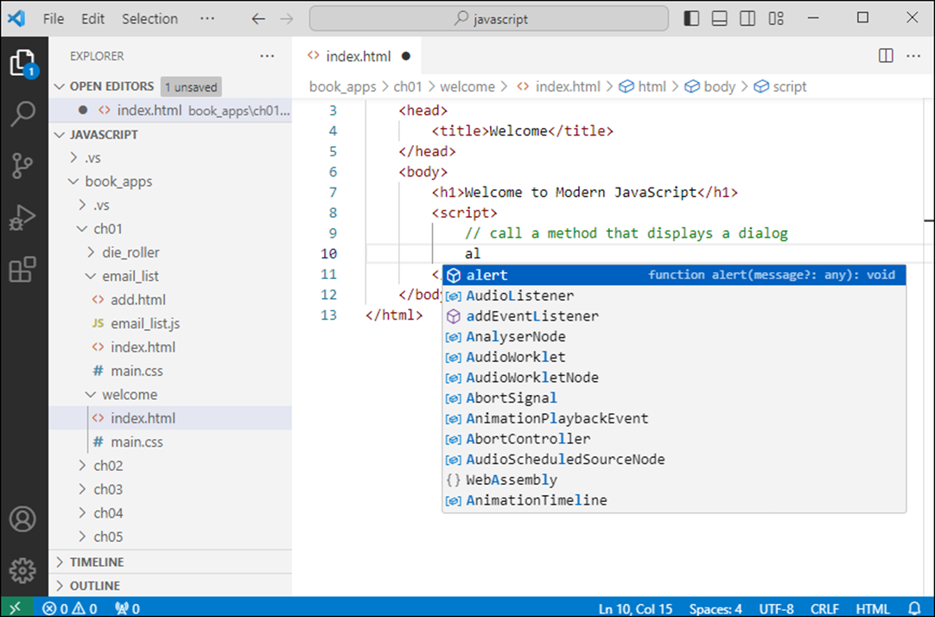
The code editor with a completion list

Slide 18
How to enter and edit code
VS Code provides features like IntelliSense and syntax highlighting that help you enter and edit code.
Use completion lists for things like keywords, variables, properties, methods, and functions so you enter them correctly.
If you enter an opening parenthesis or brace, the closing parenthesis or brace is added automatically.
If you enter an opening HTML element, the closing element is added automatically.

Slide 19
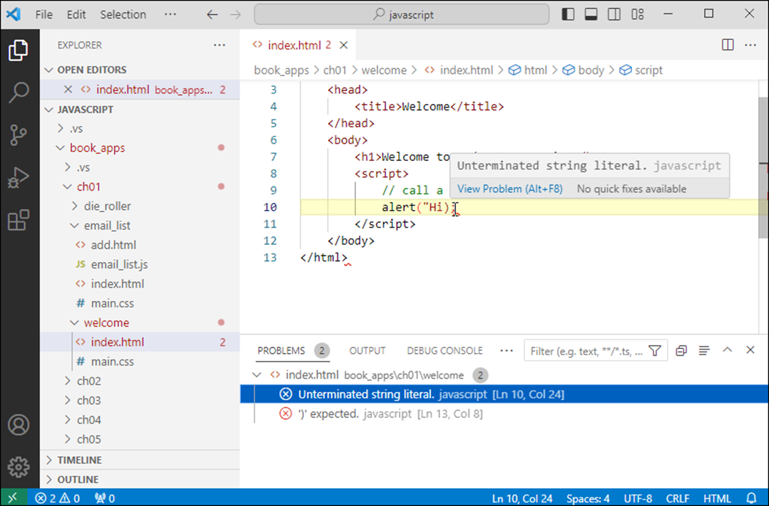
The Problems window with syntax errors

Slide 20
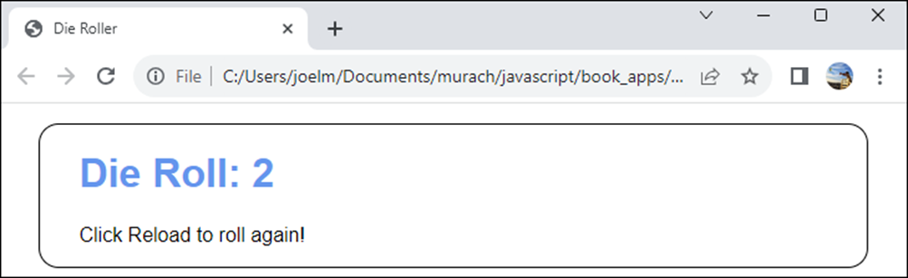
An app that simulates the roll of a die
How to test an app as you code
If you change the code for an app, you can click the Reload or Refresh button in the browser to test the updated code.

Slide 21
The code for the index.html file
<!DOCTYPE html>
<html>
<head>
<title>Die Roller</title>
<link rel="stylesheet" href="main.css">
</head>
<body>
<h1>
<script>
// get a random number between 0 and 6
const randNum = Math.random() * 6;
// round up to get a number from 1 to 6.
const dieRoll = Math.ceil(randNum);
// write some text and the number to the web page
document.write("Die Roll: " + dieRoll);
</script>
</h1>
<p>Click Reload to roll again!</p>
</body>
</html>

Slide 22
A brief description of the JavaScript
The const keyword declares a constant that stores a value that can’t be changed.
The assignment operator (=) assigns a value.
The Math.random() method returns a random decimal number between 0 and 1.
The multiplication operator (*) multiplies two numbers.
The Math.ceil() method rounds a decimal number up to the nearest integer.
The document.write() method writes text to the web page.
Double quotes identify a string of text.
The concatenation operator (+) combines text with a number.

Slide 23
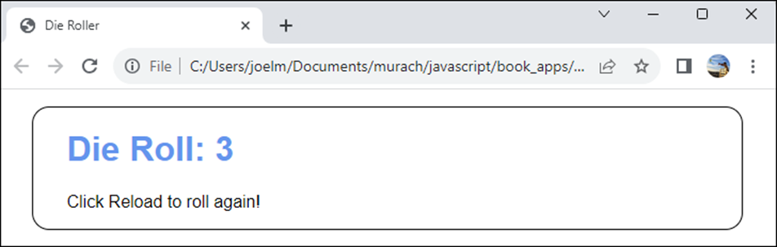
An app that’s stored on the local file system
Two ways to run an app from the file system
Use File Explorer (Windows) or Finder (macOS) to find the HTML file. Then, double-click it.
Click a link in the current web page to load the next web page.
Two ways to run an app from a web server
Enter the URL of the web page into the browser’s address bar.
Click a link in the current web page to load the next web page.

Slide 24
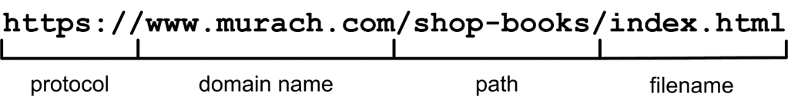
The components of a URL
What happens if you omit parts of a URL
If you omit the protocol, the browser uses the default of http:// or https://.
If you omit the filename, the browser uses the default document name for the web server, typically index.html, default.htm, or some variation.

Slide 25
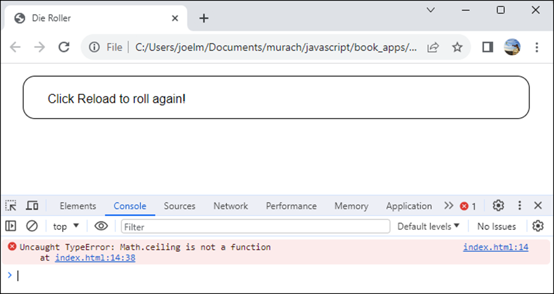
The Console panel of the developer tools with a runtime error

Slide 26
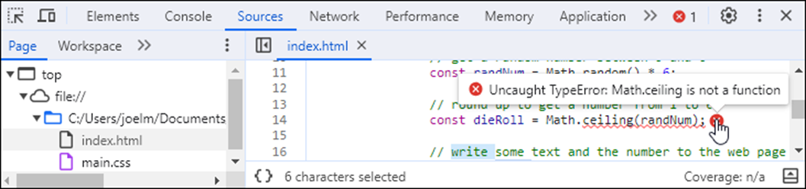
The Sources panel after the link in the Console panel is clicked

Slide 27
How to use the developer (F12) tools
To open or close the developer tools in your browser, press F12 or look up the specific shortcut key for your browser of choice.
To change where the developer tools are displayed, click the More Actions menu (three vertical dots) and select a Dock Side item.
To display a panel, click its tab.
How to get more information about an error
In the Console panel, click the link to the right of the error message that indicates the line number that caused the error. This will open the Sources panel and display the statement that caused the error.
Hover your cursor over the red X to view the error message.

Slide 28
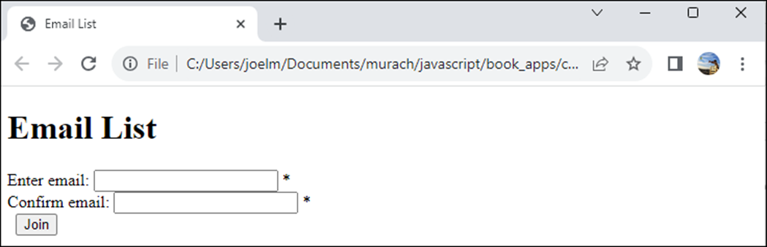
A web page before CSS is applied

Slide 29
The HTML for the web page (part 1)
<!DOCTYPE html>
<html>
<head>
<meta charset="UTF-8">
<meta name="viewport" content="width=device-width,
initial-scale=1">
<title>Email List</title>
<link rel="stylesheet" href="main.css">
</head>
<body>
<h1>Email List</h1>
<form id="email_form" name="email_form"
action="add.html" method="post">
<div>
<label for="email_1">Enter email:</label>
<input type="text" id="email_1" name="email_1">
<span id="email_1_error">*</span>
</div>

Slide 30
The HTML for the web page (part 2)
<div>
<label for="email_2">Confirm email:</label>
<input type="text" id="email_2" name="email_2">
<span id="email_2_error">*</span>
</div>
<div>
<label>&nbsp;</label>
<input type="submit" id="join_button"
value="Join">
</div>
</form>
<script src="email_list.js"></script>
</body>
</html>

Slide 31
What the HTML does
HTML (HyperText Markup Language) defines the structure and content of a web page.
The <link> element specifies an external style sheet named main.css.
The <script> element specifies an external JavaScript file named email_list.js.
The id attributes specify unique names that JavaScript uses to get the HTML elements.

Slide 32
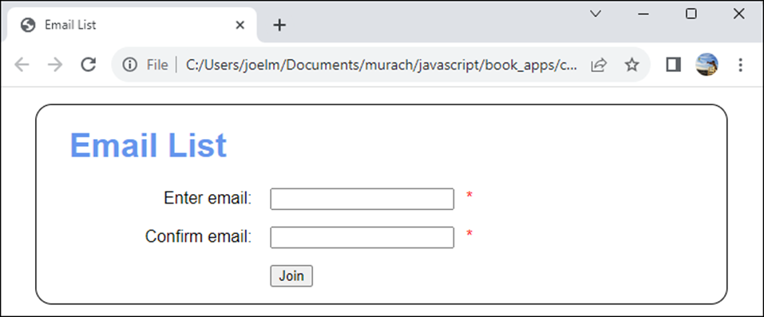
The web page after the CSS is applied

Slide 33
The CSS for the web page (part 1)
body {
font-family: Arial, Helvetica, sans-serif;
margin: 1em auto;
width: 600px;
padding: 0 2em 0;
border: 1px solid black;
border-radius: 1em;
}
h1 {
color: cornflowerblue;
}
div {
margin-bottom: 1em;
}
label {
display: inline-block;
width: 11em;
text-align: right;
}

Slide 34
The CSS for the web page (part 2)
input {
margin-left: 1em;
margin-right: 0.5em;
}
span {
color: red;
}
What the CSS does
Cascading Style Sheets (CSS) specify the fonts, colors, borders, spacing, and layouts of web pages.

Slide 35

The web page with JavaScript for data validation

Slide 36
The JavaScript for the web page (part 1)
"use strict";
// define a function that gets an HTML element
function getElement(selector) {
return document.querySelector(selector);
}
// define a function that handles the click event of the Join button
function joinButtonClick(event) {
// get user entries from text boxes
const email1 = getElement("#email_1").value;
const email2 = getElement("#email_2").value;
// check user entries
let invalid = false;
if (email1 == "") {
getElement("#email_1_error").textContent =
"Email is required.";
invalid = true;
} else {
getElement("#email_1_error").textContent = "";
}

Slide 37
The JavaScript for the web page (part 2)
if (email1 != email2) {
getElement("#email_2_error").textContent = "Emails must match.";
invalid = true;
} else {
getElement("#email_2_error").textContent = "";
}
// cancel form submit if any user entries are invalid
if (invalid) {
event.preventDefault();
}
};
// add code that's run when the web page is loaded
document.addEventListener("DOMContentLoaded", () => {
// specify the function that's run when the Join button
// is clicked
getElement("#join_button").addEventListener(
"click", joinButtonClick);
});

